Slide 1

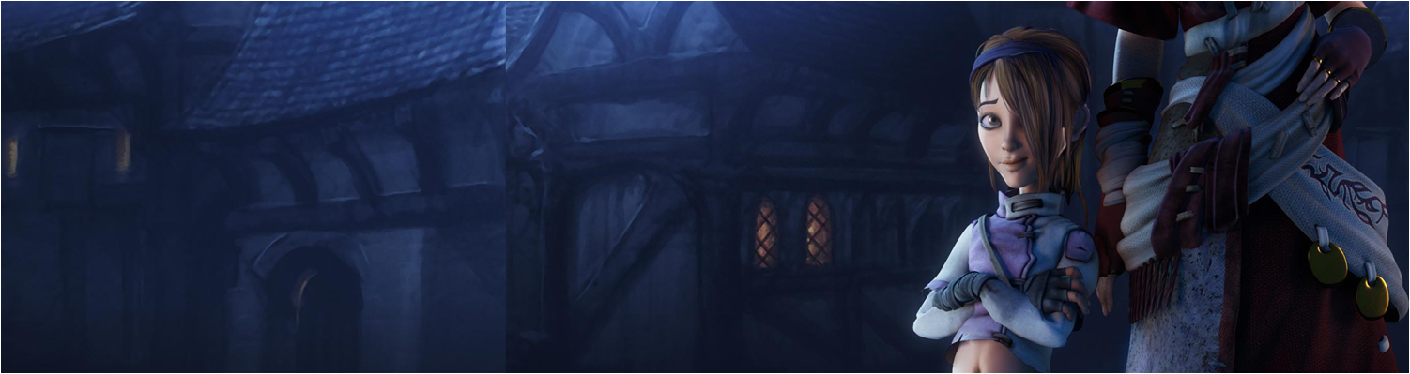

Lecture 7: Peer Review &FPS Games in Unity pt II
GAM150: Game Programming Essentials
BA Game Development

Slide 2
Today’s session:
Peer Review
Break
Introduction to Game AI in Unity

Slide 3
Peer Review

Slide 4
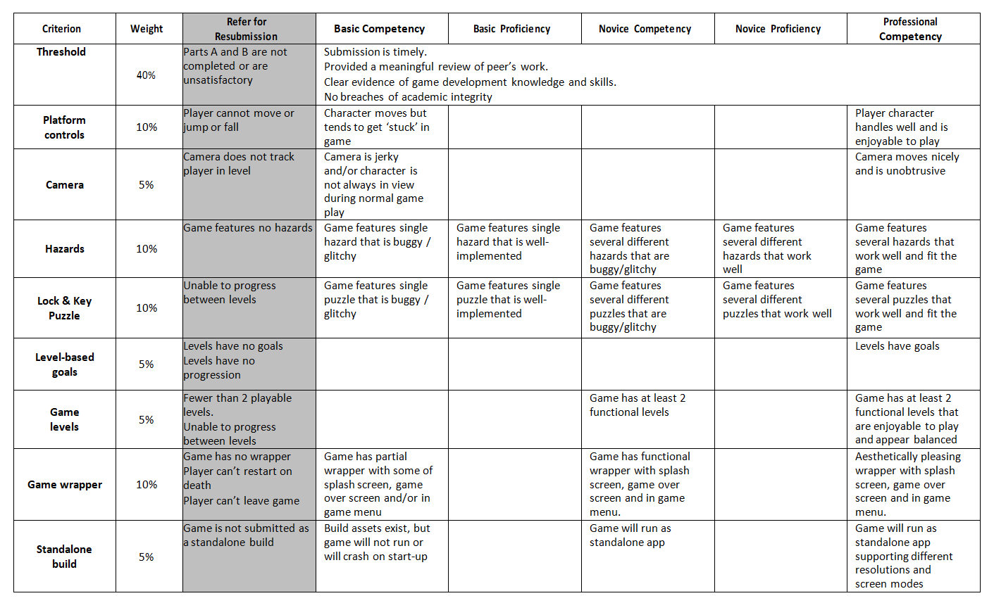
Peer Review
Here’s how it works
Doing Reviews
Be civil in your reviews
Use the assignment marking guide as a guide
Highlight any obvious bugs and issues you find
8 sections -> 8 sentences

Slide 5
Break

Slide 6
Introduction to Game AI in Unity

Slide 7
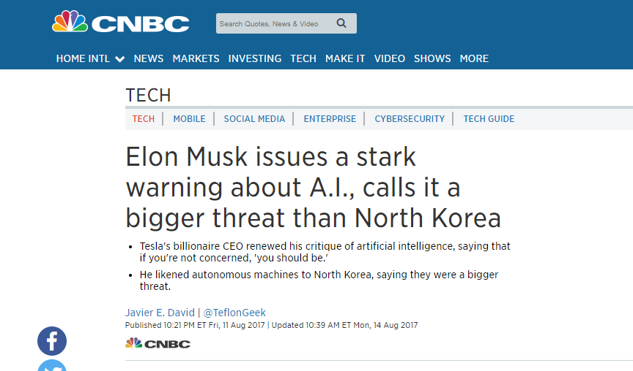
Introduction to Game AI in Unity
AI the curse of names ...
Killer robots, Skynet, job losses
The media is certainly not under reporting AI fears

Slide 8
Introduction to Game AI in Unity
AI the curse of names ...
Historically
AI has been a branch of computer science since the 1950s
Generally concerned with insights into human thought process
Making computational devices that can perform human thought activities cheaper / more accurately than humans
Ideal in areas where human knowledge is rare / limited
Medical expert systems
Automated trading
Ideal where tasks are considered dull or repetitive
Route planning / satnav
Autonomous vehicles
Ideal to support human creativity
Alexa, garageband drummer, intelligent cameras etc

Slide 9
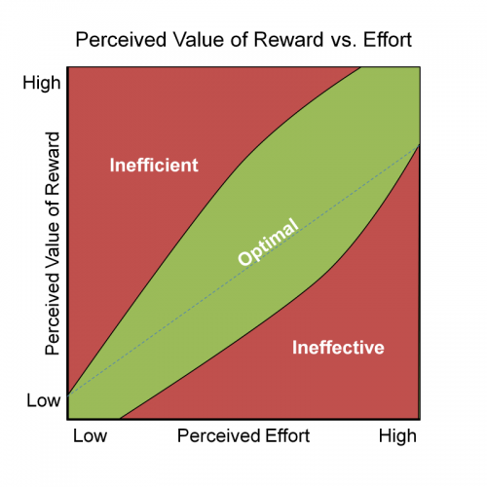
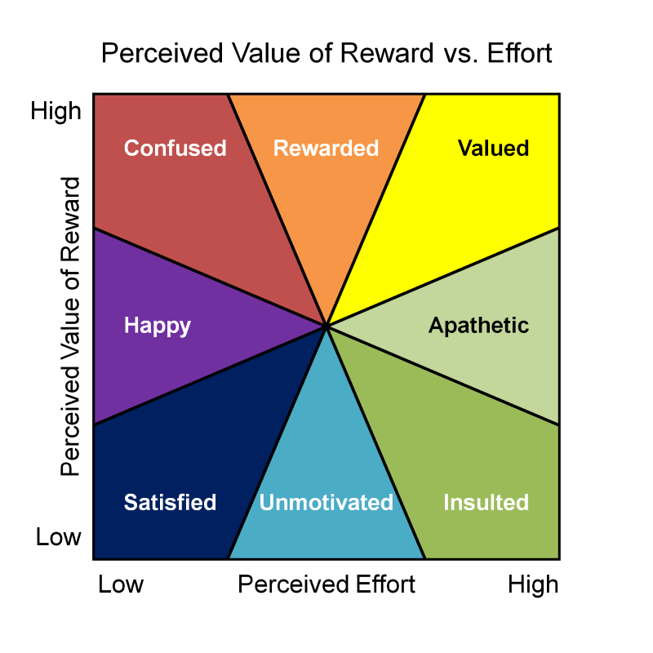
Introduction to Game AI in Unity
AI the curse of names ...
Game AI
Is a branch of AI that looks to provide human players with an ‘appropriate’ level of challenge in games
Performing more accurately than players is not necessarily a good thing
https://www.gamified.uk/2015/08/04/balancing-rewards-against-effort-in-gamification/

Slide 10
Introduction to Game AI in Unity
AI the curse of names ...
Game AI
Is a branch of AI that looks to provide human players with an ‘appropriate’ level of challenge in games
Players wont keep playing a game if:
They continually get their arse handed to them (too hard)
There is no challenge (too easy)

Slide 11
Introduction to Game AI in Unity
Implementing game AI
Game AI is a game of two halves:
What does the agent want to do
How is the agent going to do it

Slide 12
Introduction to Game AI in Unity
Implementing game AI
Game AI is a game of two halves:
What does the agent want to do
Making a decision
What does the agent know about their desires
What is the state of the game world
What is the agent going to do based on that knowledge
How is the agent going to do it

Slide 13
Introduction to Game AI in Unity
Implementing game AI
Game AI is a game of two halves:
What does the agent want to do
Making a decision
What does the agent know about their desires
What is the state of the game world
What is the agent going to do based on that knowledge
Scope for cheating / realism based on what world knowledge the agent can access
Gameobject.Find() will tell us everything
Is this ‘ethical’
Drive towards ‘sensory’ AI
How is the agent going to do it

Slide 14
Introduction to Game AI in Unity
Implementing game AI
Game AI is a game of two halves:
What does the agent want to do
Making a decision
We can implement this through state machines
How is the agent going to do it

Slide 15
Introduction to Game AI in Unity
Implementing game AI
Game AI is a game of two halves:
What does the agent want to do
How is the agent going to do it
Planning
How can an agent get to somewhere in the game world to do something?
Route finding

Slide 16
Introduction to Game AI in Unity
Implementing game AI
Route finding
We’ll look at this first as it underpins all the decision making ;)
Unity provides a lot of functionality for route finding
We can concentrate our efforts on using this functionality to achieve what we need to

Slide 17
Introduction to Game AI in Unity
Implementing game AI
Route finding
Let’s have a look at an example with Brackeys
https://www.youtube.com/watch?v=CHV1ymlw-P8
We’ll use this example as a starting point for doing interesting things with navigation.

Slide 18
Introduction to Game AI in Unity
Implementing game AI
Route finding
Let’s have a look at an example with Brackeys
https://www.youtube.com/watch?v=CHV1ymlw-P8
We’ll use this example as a starting point for doing interesting things with navigation.
There’s a set of code as a link on the video
Watch out as the mesh has no mesh collider component so the raycasting wont work as it stands
I’ve extended the demo to make 01. Static Navmesh

Slide 19
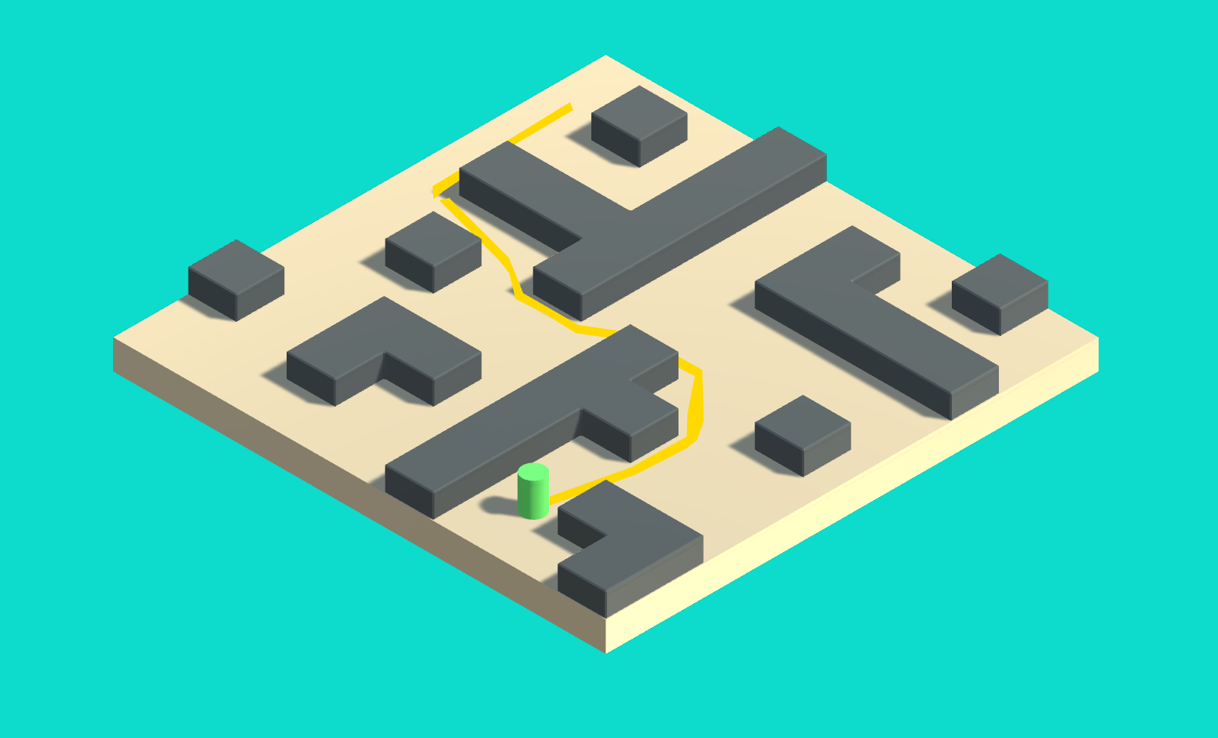
Introduction to Game AI in Unity
Implementing game AI
Route finding 01. Static Navmesh

Slide 20
Introduction to Game AI in Unity
Implementing game AI
Route finding: 01. Static Navmesh
We need to be careful with the raycast as you may select a wall (and you can’t navigate to that)
Raycast all will return all the objects the ray hits
If any of them have ‘walls’ as a name, we can’t go there
It would be nice to see the route the player is taking
https://answers.unity.com/questions/361810/draw-path-along-navmesh-agent-path.html
Bolt on code that will do this

Slide 21
Introduction to Game AI in Unity
Implementing game AI
Route finding: 01. Static Navmesh
Be careful with the inspector values for the navmesh agent
Navmesh uses Astar algorithm
(https://en.wikipedia.org/wiki/A*_search_algorithm)
Guaranteed to give the ‘best’ route between points
However, speed and acceleration will ‘fix’ that as the agent is implemented with a locomotion model of acceleration, speed, turning and braking
Make acceleration higher than speed for best results (unless you want leery agents)

Slide 22
Introduction to Game AI in Unity
Implementing game AI
Introducing behaviours
We’ve now got an environment where agents can move around
This is the lower part of out AI stack
We need to work out where there should go and what they need to do when they get there

Slide 23
Introduction to Game AI in Unity
Implementing game AI
Introducing behaviours
02. Baddies pt1
Let’s take the first example and make the game world bigger by duplicating it
And remembering to re-bake the new navmesh ;)

Slide 24
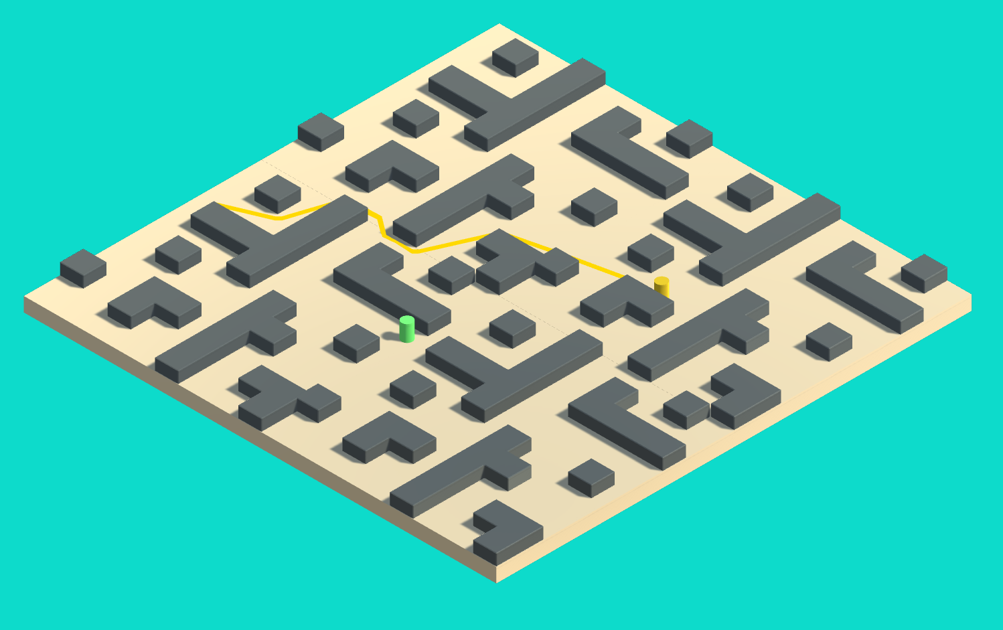
Introduction to Game AI in Unity
Implementing game AI
Introducing behaviours
02. Baddies pt1

Slide 25
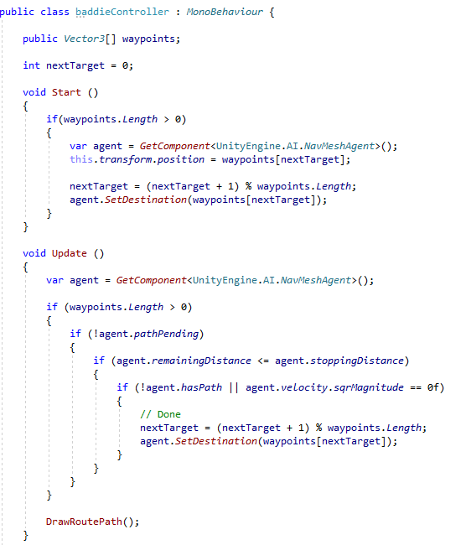
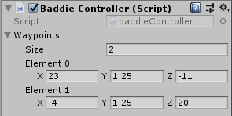
Introduction to Game AI in Unity
Implementing game AI
Introducing behaviours
02. Baddies pt1
Let’s make a baddie by duplicating the baddie and giving them a new script
We want to give the baddie an array of vectors to define a movement route

Slide 26
Introduction to Game AI in Unity
Implementing game AI
Introducing behaviours
02. Baddies pt1
In Start() we will get the first destination and set the baddie to navigate to there

Slide 27
Introduction to Game AI in Unity
Implementing game AI
Introducing behaviours
02. Baddies pt1
In Start() we will get the first destination and set the baddie to navigate to there
In Update() we will see if the baddie is at their destination
If they are, we’ll get the next destination in the array, or the first one if they are at the last destination
If they aren’t, no worries we’ll leave them to it

Slide 28
Introduction to Game AI in Unity
Implementing game AI
Introducing behaviours
02. Baddies pt1

Slide 29
Introduction to Game AI in Unity
Implementing game AI
Introducing behaviours
02. Baddies pt1
Again, baddie & player still a bit drunk
Make acceleration much higher than speed
Make stopping distance 0
Make Angular speed (turning speed) large
You can see that these variables are ‘like’ a vehicle ;)

Slide 30
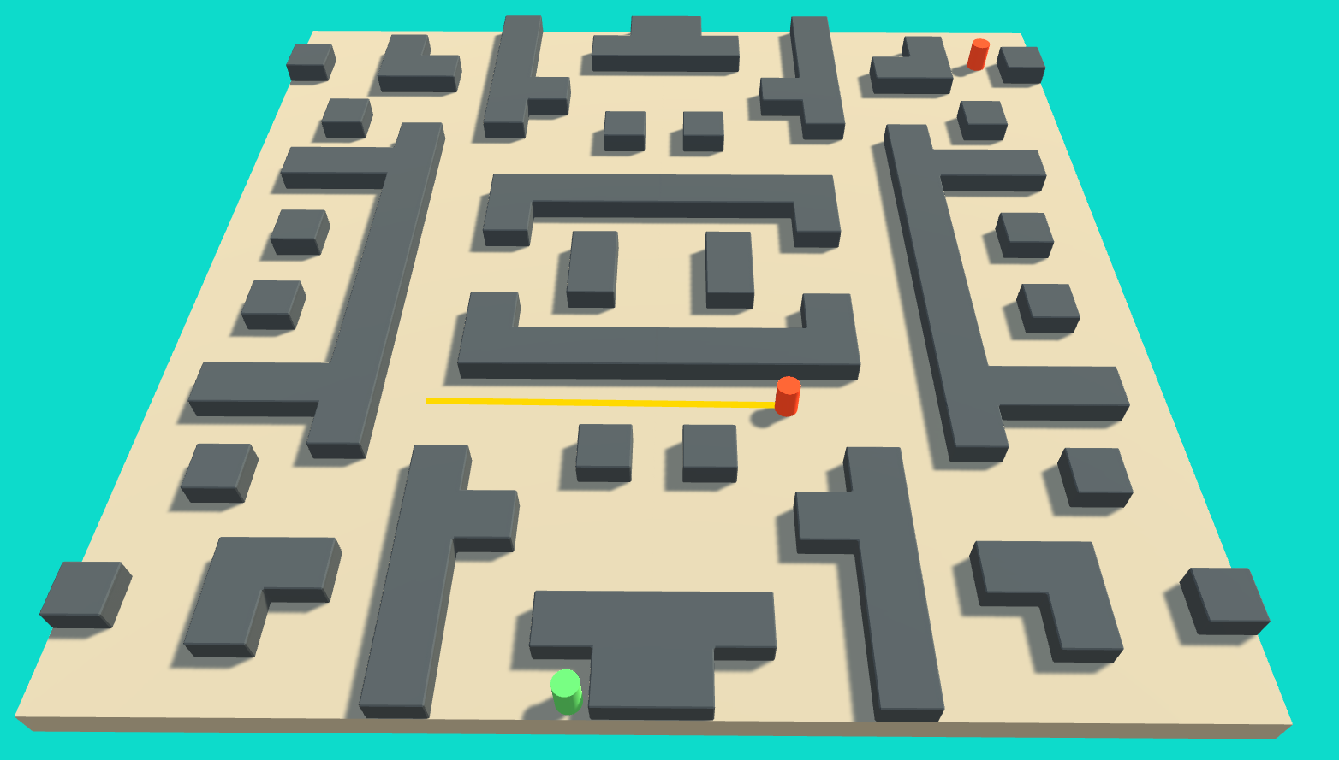
Introduction to Game AI in Unity
Implementing game AI
Introducing behaviours
03. Baddies pt II

Slide 31
Introduction to Game AI in Unity
Implementing game AI
Introducing behaviours
03. Baddies pt II
We can use this approach to give us baddies that will diligently follow their orders to patrol
And do different things

Slide 32
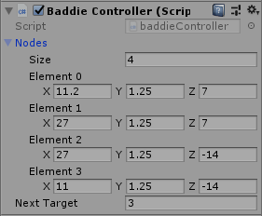
Introduction to Game AI in Unity
Implementing game AI
Introducing behaviours
03. Baddies pt II
First, we can add another baddie that will patrol the ‘important’ middle of the level
Re-use the existing baddie controller, but get the baddie to follow 4 points in a rectangle

Slide 33
Introduction to Game AI in Unity
Implementing game AI
Introducing behaviours
03. Baddies pt II
Now, let’s give a baddie a choice of things to do
Patrol
Or look at the player when they can see them

Slide 34
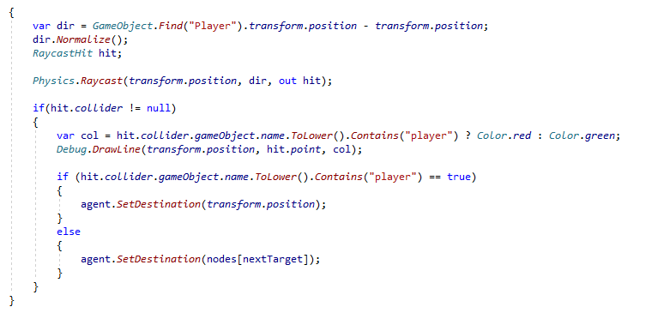
Introduction to Game AI in Unity
Implementing game AI
Introducing behaviours
03. Baddies pt II
Now, let’s give a baddie a choice of things to do
Patrol
Or look at the player when they can see them
In Update()

Slide 35
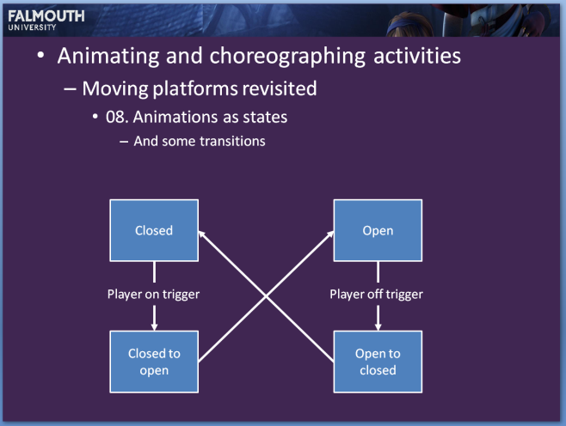
Introduction to Game AI in Unity
Implementing game AI
03. Baddies pt II
This effectively gives us the implementation of a finite state machine
Just like what we had the other week with the ‘door of doom’
Patrol
Can see player
Look
Can see player

Slide 36
Introduction to Game AI in Unity
Implementing game AI
04. Baddies pt III
Structure the baddies better
Let’s make the code a bit easier to follow ....

Slide 37
Introduction to Game AI in Unity
Implementing game AI
04. Baddies pt III
Structure the baddies better
Let’s make the code a bit easier to follow ....
I’m going to have a function that will work out what the baddie should do
And a function that will do it

Slide 38
Introduction to Game AI in Unity
Implementing game AI
04. Baddies pt III
Structure the baddies better
Let’s make the code a bit easier to follow ....
I’m going to have a function that will work out what the baddie should do
And a function that will do it
This makes it much easier to make the AI system extensible

Slide 39
Introduction to Game AI in Unity
Implementing game AI
Introducing behaviours
Demo 3 : Baddies that do different things
DecideWhatToDo()
Choose which action the baddie should do based on whether they can see the player
Effectively, we are slicing and dicing the original Update() function
But removing the code that actually does the updating

Slide 40
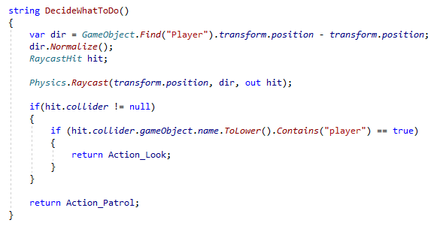
Introduction to Game AI in Unity
Implementing game AI
Introducing behaviours
Demo 3 : Baddies that do different things
DecideWhatToDo()

Slide 41
Introduction to Game AI in Unity
Implementing game AI
Introducing behaviours
Demo 3 : Baddies that do different things
Update()
Call DecideWhatToDo() and do what it recommends
Again, this is slicing and dicing the Update()

Slide 42
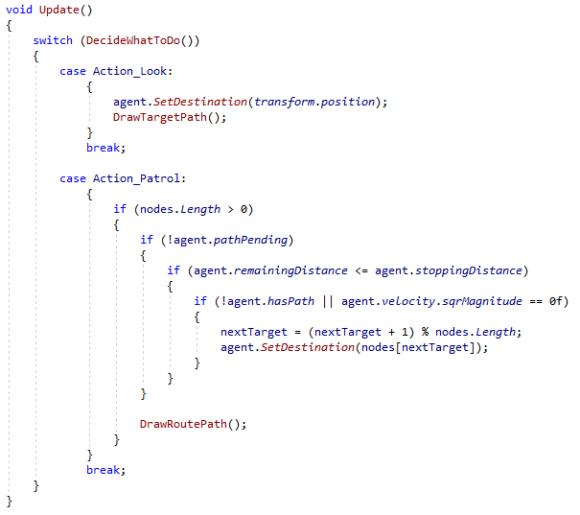
Introduction to Game AI in Unity
Implementing game AI
Introducing behaviours
Demo 3 : Baddies that do different things
Update()

Slide 43
Introduction to Game AI in Unity
Implementing game AI
Introducing behaviours
Taking it further ...

Slide 44
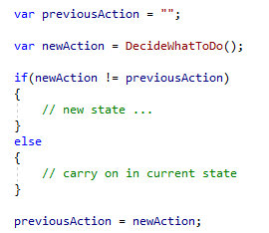
Introduction to Game AI in Unity
Implementing game AI
Introducing behaviours
DecideWhatToDo()
Can use the output of this function to detect changes in state & react to them

Slide 45
Introduction to Game AI in Unity
Implementing game AI
Introducing behaviours
Timing
Can use unity timing to work out how long an agent is in a state with
Time.deltaTime
This is elapsed time in seconds since the last update
Normally a small value
Add them up to count seconds
Work your characters in seconds
Shoot every N seconds
In patrol, pause for N seconds at destination
etc

Slide 46
Introduction to Game AI in Unity
Implementing game AI
Introducing behaviours
Timing
Can also use animations to control timing
Add events into an animation to control shooting

Slide 47
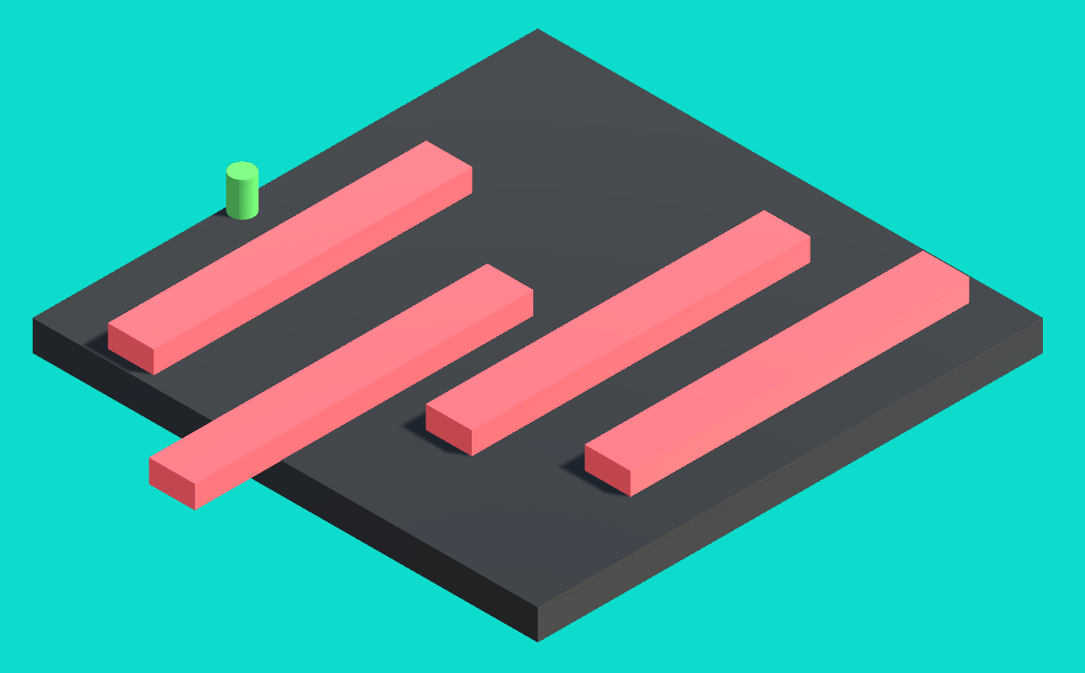
Introduction to Game AI in Unity
Dynamic Obstacles
https://www.youtube.com/watch?v=FkLJ45Pt-mY

Slide 48
Introduction to Game AI in Unity
Dynamic Obstacles
Obstacles can move to create more challenges
Dynamic NavMesh demo
Note that colliders are cubes or capsules

Slide 49
Questions?

